Slide 2
Quarks come in six different types, with six antipartners. On the A-level syllabus, you need to know about three: up, and down (which make up everyday matter), and strange.
The other three are called charm, top and bottom.

Slide 3
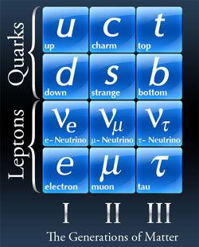
Three generations of matter
Source: the Particle Adventure

Slide 4
Protons and Neutrons: the most common hadrons

Slide 5
Types of particle

Slide 6
How to make a hadron
Electric Charge
Colour Charge

Slide 7
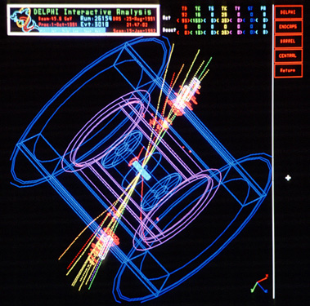
So how do we find quarks?

Slide 8
Conservations
Charge
Baryon number
Lepton number
?
Strangeness

Slide 9
Decays

Slide 10
Weak decay
In weak decay, you can ‘swap’ a down or strange quark for an up quark. This process creates one new pair of particles to conserve charge.

Slide 11
Strong decay
In strong decay, the quarks in the initial particle are rearranged to make different particles. But quark-antiquark pairs can be created, so long as they are of the same type.

Slide 12
Quark flow diagrams

Slide 13
How forces work

Slide 14
Any questions?

